Slide 1

JAVA PROGRAMMING PROJECT PRESENTATION
Project Title: Complaint Management System.
Course: Java Programming / Mini Project
Student Name & Roll No:SUDEEPA J &25BCS056
Department: Computer Science
Mentor / Guide:Dr.BOOPALAN SUNDARAMOORTHY

Slide 2
INTRODUCTION
JAVA PROGRAMMING PROJECT PRESENTATION
The Complaint Management and Resolution Tracking System is a software application designed to handle and manage complaints efficiently. It helps users to register their complaints and allows administrators to monitor, track, and resolve issues in a systematic manner.
In traditional systems, complaints are handled manually, which leads to delays, lack of transparency, and difficulty in tracking the status. This system overcomes those problems by providing a digital platform where complaints can be recorded, updated, and resolved quickly.
The system assigns a unique ID to each complaint, making it easy to track its progress. It also allows status updates such as Pending, In Progress, and Resolved, ensuring better communication between users and administrators.
Overall, this system improves efficiency, reduces response time, and enhances user satisfaction by providing a structured approach to complaint handling.

Slide 3
PROBLEM STATEMENT
JAVA PROGRAMMING PROJECT PRESENTATION
In many organizations, complaint handling is done manually or through unorganized methods, which leads to several issues:
Complaints are not recorded properly
Difficulty in tracking the status of complaints
Lack of transparency in the resolution process
Delays in responding to user issues
Chances of complaints being lost or ignored
No proper system to maintain records for future reference
Due to these problems, users experience dissatisfaction and organizations face difficulty in managing and resolving complaints efficiently.

Slide 4
OBJECTIVE
JAVA PROGRAMMING PROJECT PRESENTATION
The main objective of the Complaint Management and Resolution Tracking System is to develop an efficient and user-friendly system to handle complaints in a structured manner.
To provide an easy way for users to register complaints
To generate a unique ID for each complaint
To track the status of complaints (Pending, In Progress, Resolved)
To reduce manual work and improve efficiency
To ensure quick and timely resolution of issues
To maintain a proper record of all complaints
To improve transparency between users and administrators

Slide 5
SCOPE OF THE SYSTEM
JAVA PROGRAMMING PROJECT PRESENTATION
The Complaint Management and Resolution Tracking System is designed to provide a simple and effective platform for handling complaints within an organization.
The system allows users to register and submit complaints easily
It enables storage and management of complaint data in a structured format
Users can view and track the status of their complaints at any time
Administrators can monitor, update, and resolve complaints efficiently
The system supports status updates such as Pending, In Progress, and Resolved
It maintains records of all complaints for future reference and analysis
The system can be used in various environments such as colleges, offices, hospitals, and customer service centers.

Slide 6
SYSTEM MODULES
JAVA PROGRAMMING PROJECT PRESENTATION
User Module – Used to add complaints and check status
Complaint Management Module – Creates and stores complaints with unique ID
Admin Module – Views complaints and updates status
Status Tracking Module – Shows complaint progress (Pending, In Progress, Resolved)
Data Management Module – Stores complaint details using ArrayList

Slide 7
SYSTEM WORKFLOW
JAVA PROGRAMMING PROJECT PRESENTATION
Start
↓
User submits complaint
↓
Generate Complaint ID
↓
Store Complaint
↓
Admin views complaint
↓
Update Status
↓
User checks status
↓
End

Slide 8
JAVA CONCEPT USED
JAVA PROGRAMMING PROJECT PRESENTATION
Class and Object – Used to create Complaint objects
ArrayList – Used to store complaint records dynamically
Encapsulation – Data and methods are combined in a class
Constructor – Used to initialize complaint details
Loop (while) – Used for continuous menu execution
Conditional Statements (if, switch) – Used for decision making
Methods – Used to perform operations like add, view, update
Scanner Class – Used to get user input
Java Swing (Optional) – For GUI-based version of the system

Slide 9
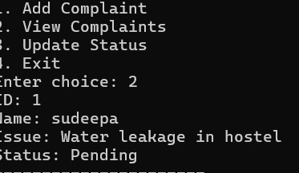
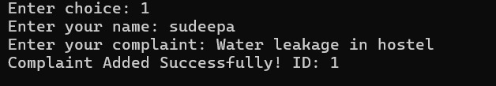
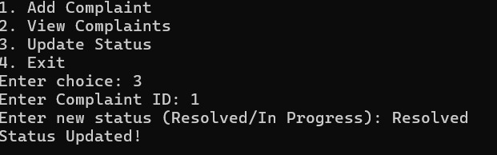
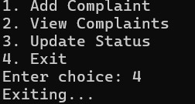
OUTPUT OF PROGRAM
S
JAVA PROGRAMMING PROJECT PRESENTATION

Slide 10
DEMONSTRATION STEPS
JAVA PROGRAMMING PROJECT PRESENTATION
Run the Java program
Display the main menu
Select Add Complaint option
Enter user name and complaint
System generates complaint ID
Select View Complaints to see details
Select Update Status option
Enter complaint ID and update status
View updated complaint status
Select Exit to close the program

Slide 11
CONCLUSION
JAVA PROGRAMMING PROJECT PRESENTATION
The Complaint Management and Resolution Tracking System provides an efficient way to handle complaints in a structured manner. It reduces manual work and helps in tracking complaint status easily.
The system ensures faster resolution, better organization of data, and improved user satisfaction. It is simple, user-friendly, and useful for various organizations.
Overall, this project demonstrates how a basic system can improve complaint handling and management effectively.

Slide 12
FUTURE ENHANCEMENT
JAVA PROGRAMMING PROJECT PRESENTATION
Add database support (MySQL) for permanent data storage
Develop a user-friendly GUI interface
Implement login and authentication system
Add email/SMS notifications for status updates
Create a mobile application version
Generate reports and analytics for complaints
Improve security and data management

Slide 13
THANK YOU

